Slide 1

Creating your Digital Roadmap within DXC Digital Explorer
Roadmaps release 1.2.8
DXC Workplace group

Slide 2
Contents
Overview
Digital Explorer Roadmap module output
Definition of terms
roadmap metamodel
Creating your roadmap
Viewing your roadmap
Creating strategic programs
Horizon diagram and value chain views
Roadmap Insights
Supporting template

Slide 3
DXC Digital Explorer
Jira
In place
Market trends
Client Strategy
EPIC
Planned/part of the DE/ASD roadmap
Digital Roadmap
User Story
Role of DE? Enough information should be there
IDEA
User Story
Innovation Agenda
Digital Transformation Map
User Story
Goals
KPIs
Trends
Solution Model ASD Concept
MS Teams
Motivations
Project Team space
GitHub
Solution Model ASD Prototype
Solution Repo
Solution Model ASD ….
Solution Repo

Slide 4
Refining our knowledge to Client Ideas
Review the Business Trends within Digital Explorer
Review the technology trends within Digital Explorer
Business Trends
Technology Trends
Define the value chains for your client
Map the relevant trends into each value chain
Identify the focus area trends
Value Chain
Value Chain
Value Chain
Group focus areas into strategic initiatives
Ideas
Ideas
Ideas

Slide 5
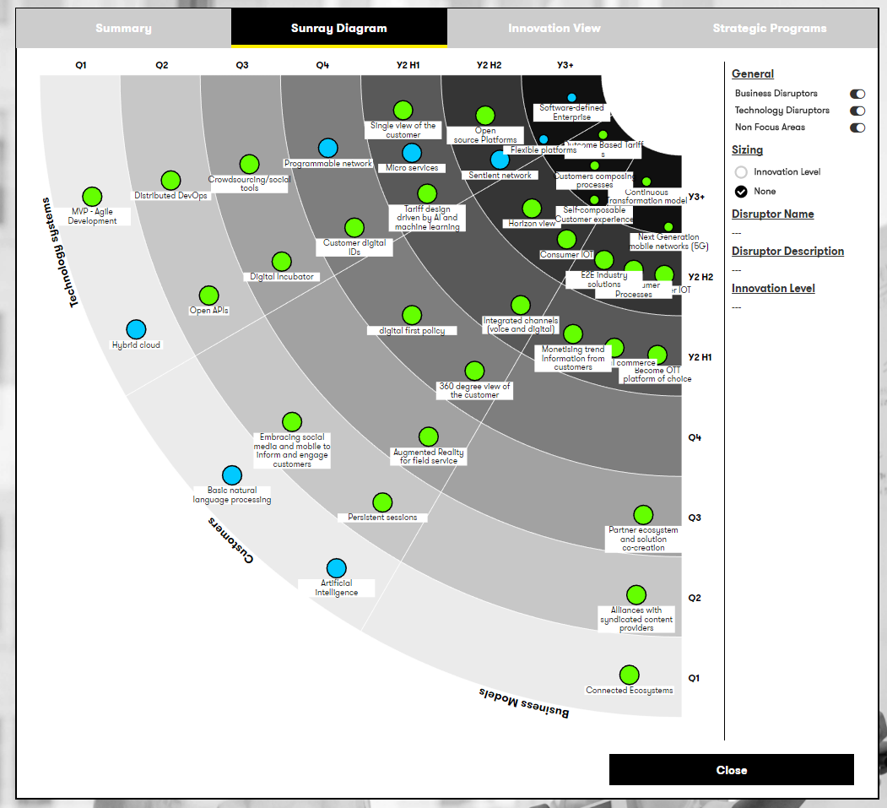
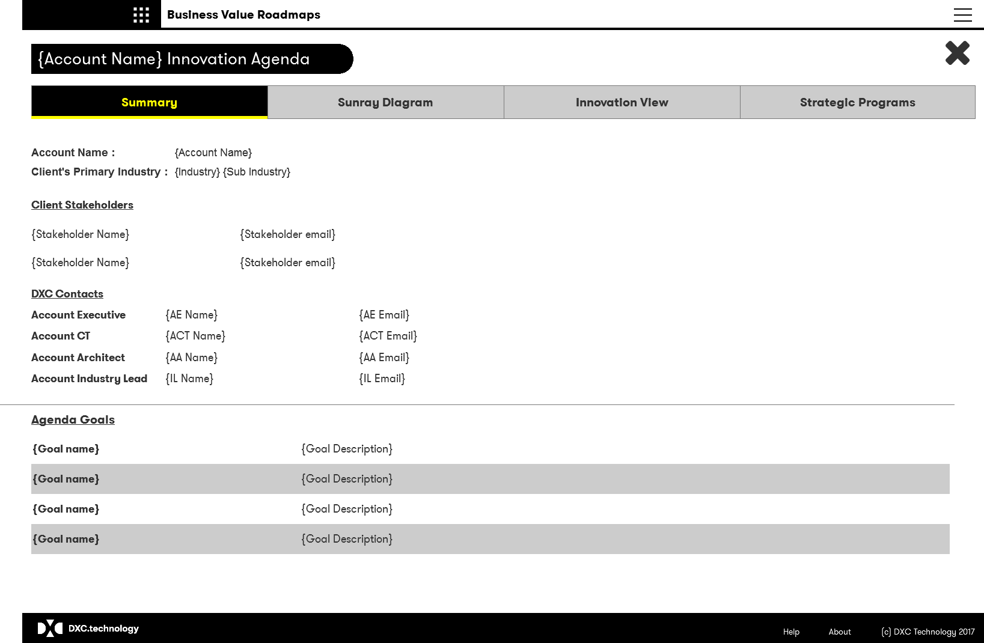
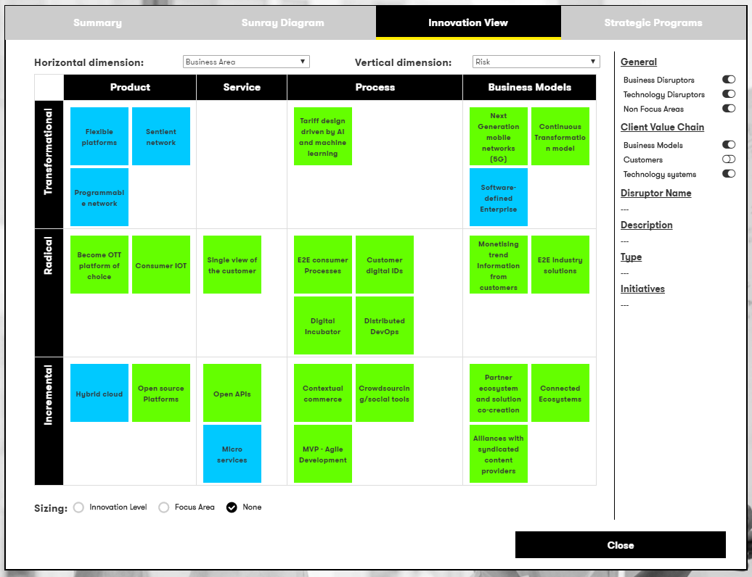
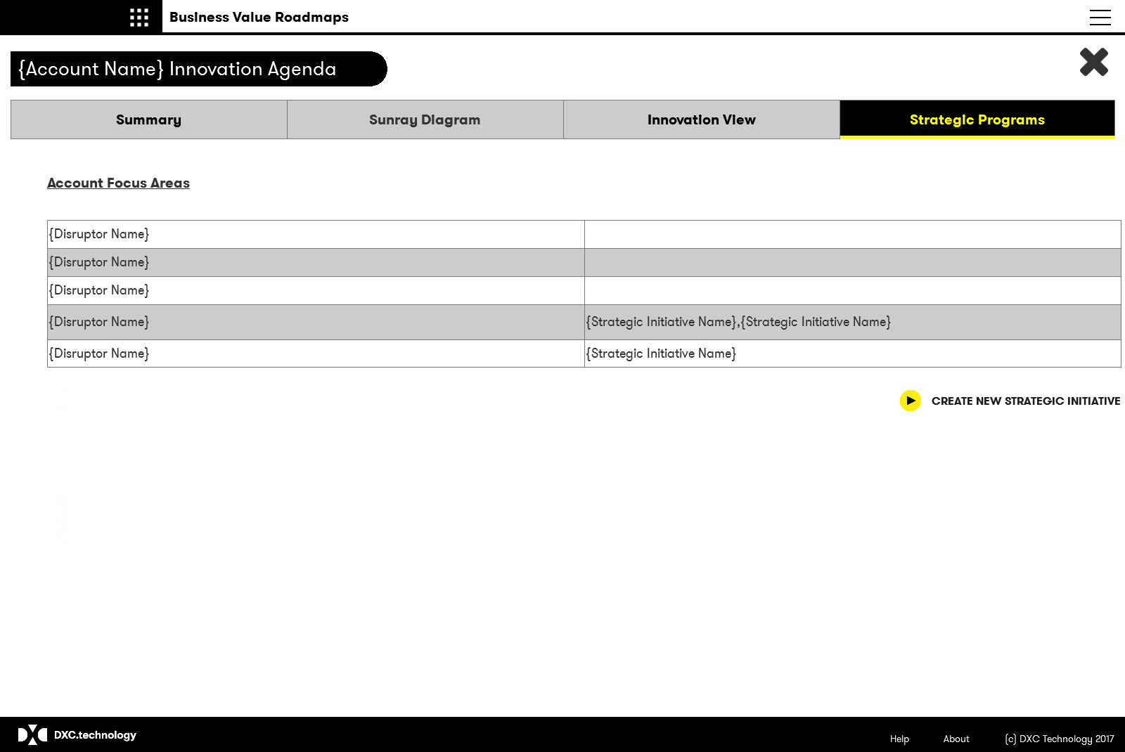
Digital Roadmaps - Output
Summary
Sunray Diagram
General information related to the client and the roadmap
Sunray via of all client value chains, reaching towards the roadmap goals
Innovation Risk Table
Ideas
Dynamic table to present the business area and innovation levels for each client trend
Create and view details of identified client strategic programs identified through the innovation roadmap

Slide 6
Digital Roadmap model
Client Innovation level
I
R
T
Related business area
Pd
S
Ps
B
Roadmap
Goal
Goal
Goal
Goal
KPI
KPI
KPI
KPI
Client Value Chain/Business Area
Client Value Chain/Business Area
KPI
KPI
KPI
KPI
KPI
KPI
Business Trends
Technology Trends
Signal
Business Trends
Technology Trends
Signal
I
R
T
I
R
T
I
R
T
I
R
T
I
R
T
I
R
T
Pd
S
Ps
B
Pd
S
Ps
B
Pd
S
Ps
B
Pd
S
Ps
B
Pd
S
Ps
B
Pd
S
Ps
B
Idea
Idea
See next slide for definition of terms

Slide 7
Definition of terms
Term | Description
Roadmap Name | Friendly name of the innovation roadmap
Roadmap Description | Detailed description of the innovation roadmap
Roadmap Goal | Represents a high-level statement of intent, direction, or desired end state for the roadmap
Client Value Chain | A value chain is a process or activity within an industry, which provides direct internal or external benefit or revenue. (examples : Business Models, Aftermarket care, Customer Experience, Design).
Client Value Chain Business Area | A mapping to the relevant business area for the value chain as defined within the overall industry innovation model.
Client Value Chain KPI | A known Key Performance Indicator for the client's value chain.
Client Value Chain Stakeholder | Name of any known stakeholders for the define client value chain
Roadmap Stakeholder | Name of any known stakeholders for the overall innovation roadmap
Trend | Short name of the Trend - default is the value from Digital Explorer, but can be overwritten to reflect the clients terminology
Trend Description | Detailed description of the Trend - default is the value from Digital Explorer, but can be overwritten to reflect the clients terminology
Signal
Trend innovation level: Incremental | Addressing this Trend has incremental impact and benefit for the customers’ business (e.g Evolutionary roadmap item improves effectiveness or efficiency of a product, service process or business model) Evolutionary roadmap item
Trend innovation level: Radical | Addressing this Trend has a radical impact and benefit to the customers’ business (e.g brings customer up to top quartile performance in the area in terms of product, service process or business model)
Trend innovation level: Transformational | Addressing this Trend has Transformational impact on the customers’ business, (e,g clear blue water between customer and followers in terms of product, service process or business model)
Trend Business Area: Product
Trend Business Area: Service
Trend Business Area: Process
Trend Business Area: Business Model
Focus Area | Flag to highlight if a Trend is a focus area for the account team
Client Strategic Initiative | A committed account initiative based on the output of the innovation roadmap, can address one or more focus Trends.

Slide 8
Approach
Understand Client and Industry direction
Create the initial roadmap
Refine/discuss roadmap with account team and client
BVF
Business and Technology Trends
Client Value Chains
Stakeholders
Key trends
Innovation levels
Focus areas
Outline account plan
Strategic initiatives

Slide 9
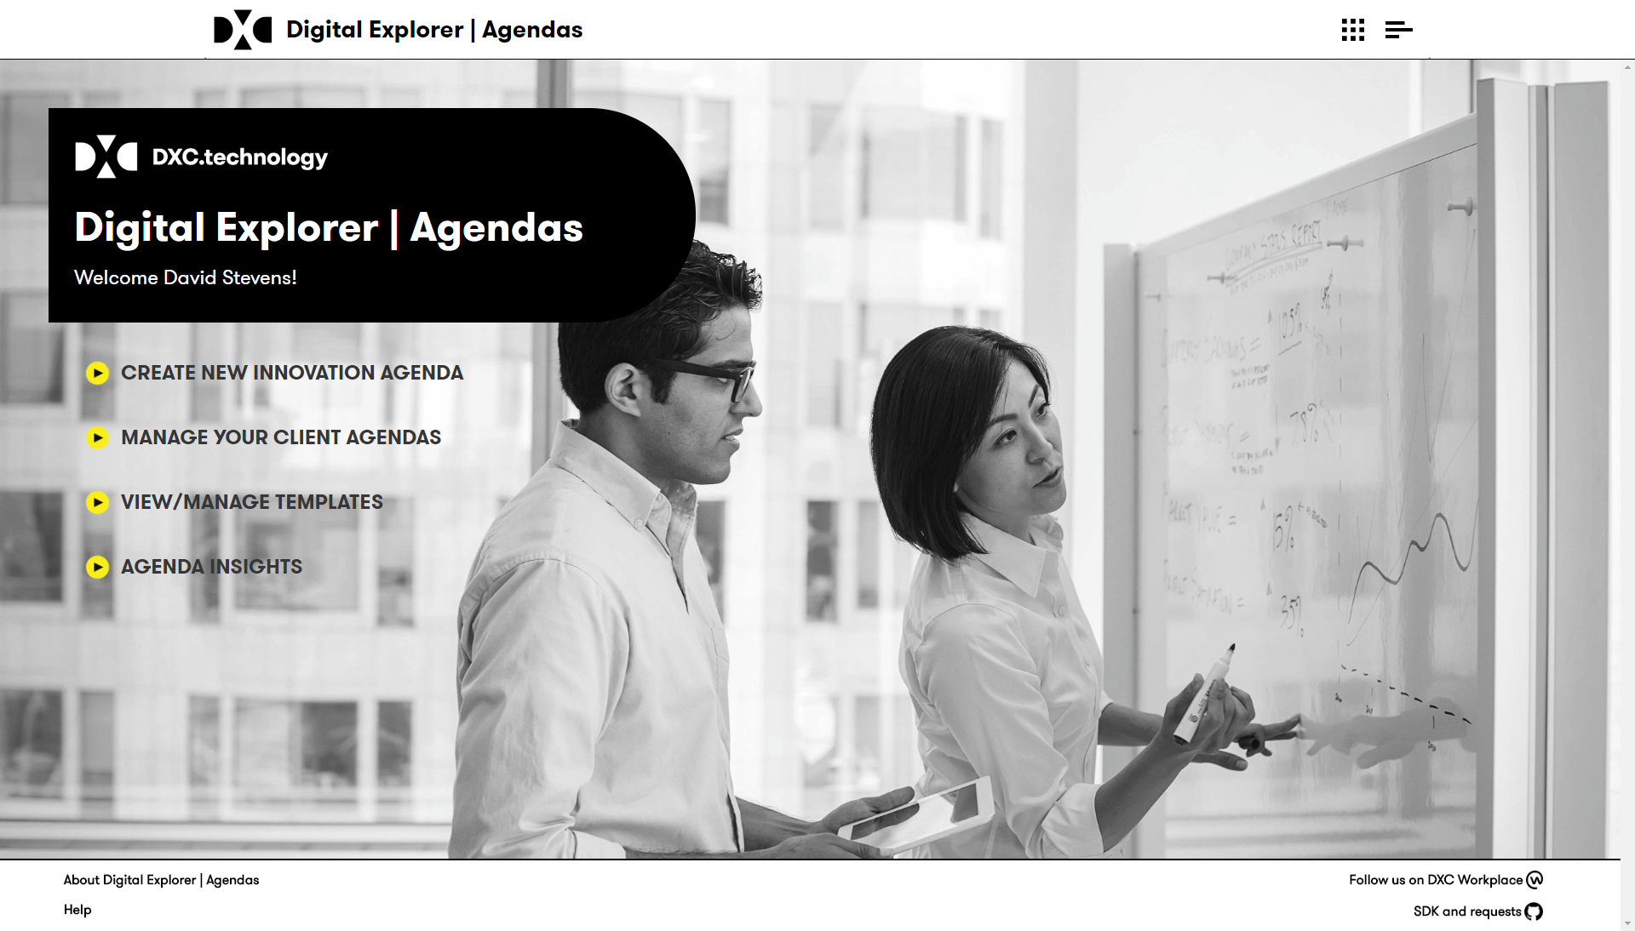
Innovation roadmap landing page
Once logged in you can
Create a new innovation roadmap
Manage your existing roadmap
View trend insights across all roadmaps

Slide 10
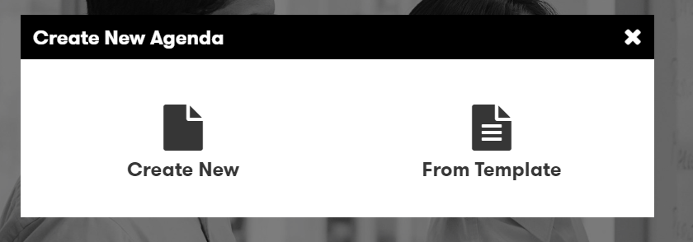
Digital Roadmap 1/5
Select to create either a new (blank) roadmap or start from an roadmap template

Slide 11
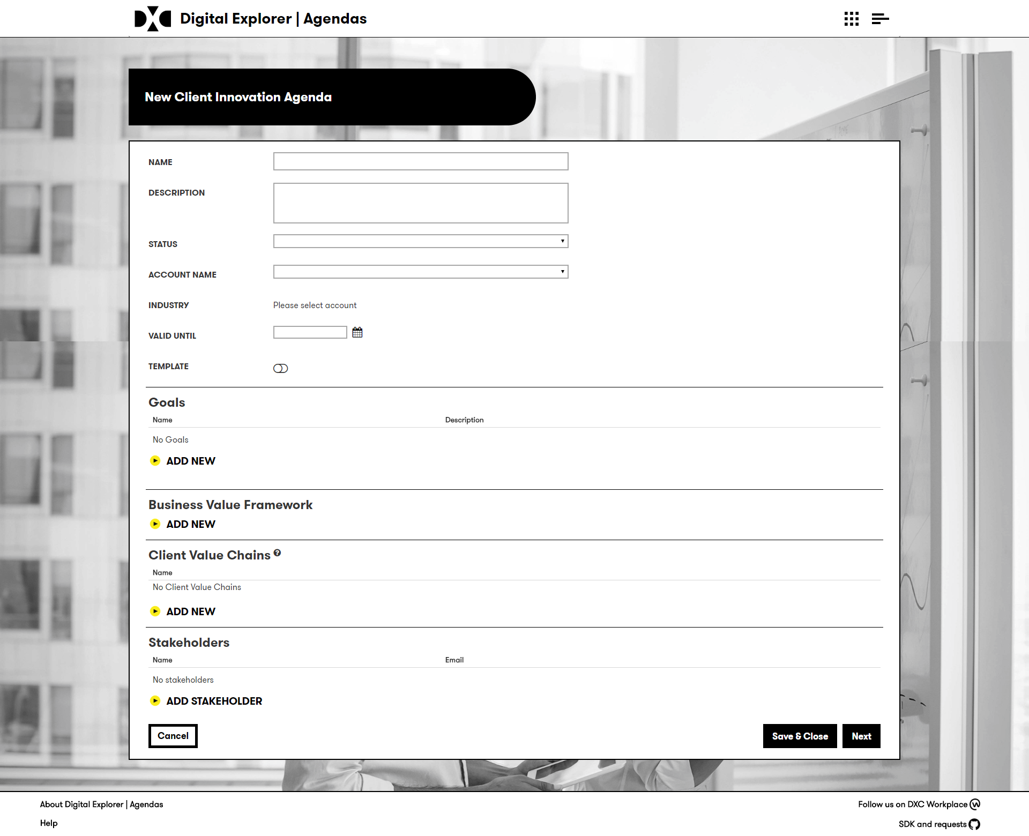
Digital Roadmap 2/5
Select “Create new roadmap” from the homepage
Enter the name and description
Select from the list of available account
if your account is not listed, contact the support team
You can also select “training account” to create a test roadmap
Select a “valid until” date
Add the goals related to the roadmap – these should be taken from the account BVF.
You can add the BVF as an image
Client Value Chains – The module will automatically create the industry value chains (as defined within DE)
Add the details of any key stakeholders

Slide 12
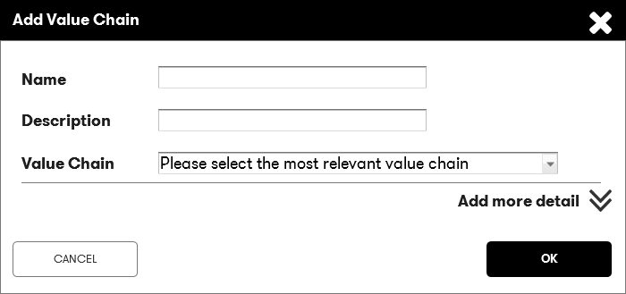
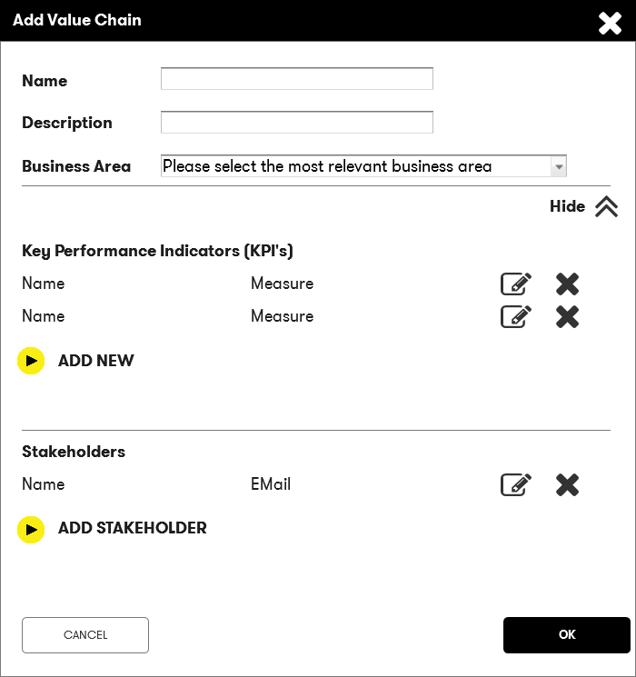
Digital Roadmap 3/5
Waiting for updated UI
The tool will automatically create the industry value chains as defined within Digital Explorer for your clients industry.
You can delete or add new value chains as required.
Enter the name and description of the client value chain
Select an appropriate business area for the initiative
Expand the dialog to add any additional information:
Enter any known KPI’s for this value chain
Add any key stakeholders
You can also add these via the canvas

Slide 13
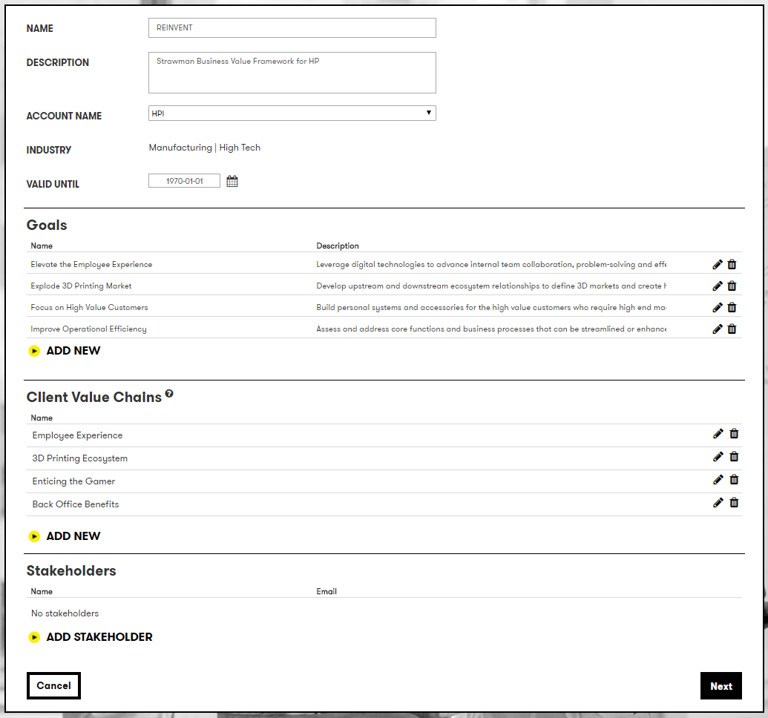
Digital Roadmap 4/5
Once you have completed the initial set of information click “next”

Slide 14
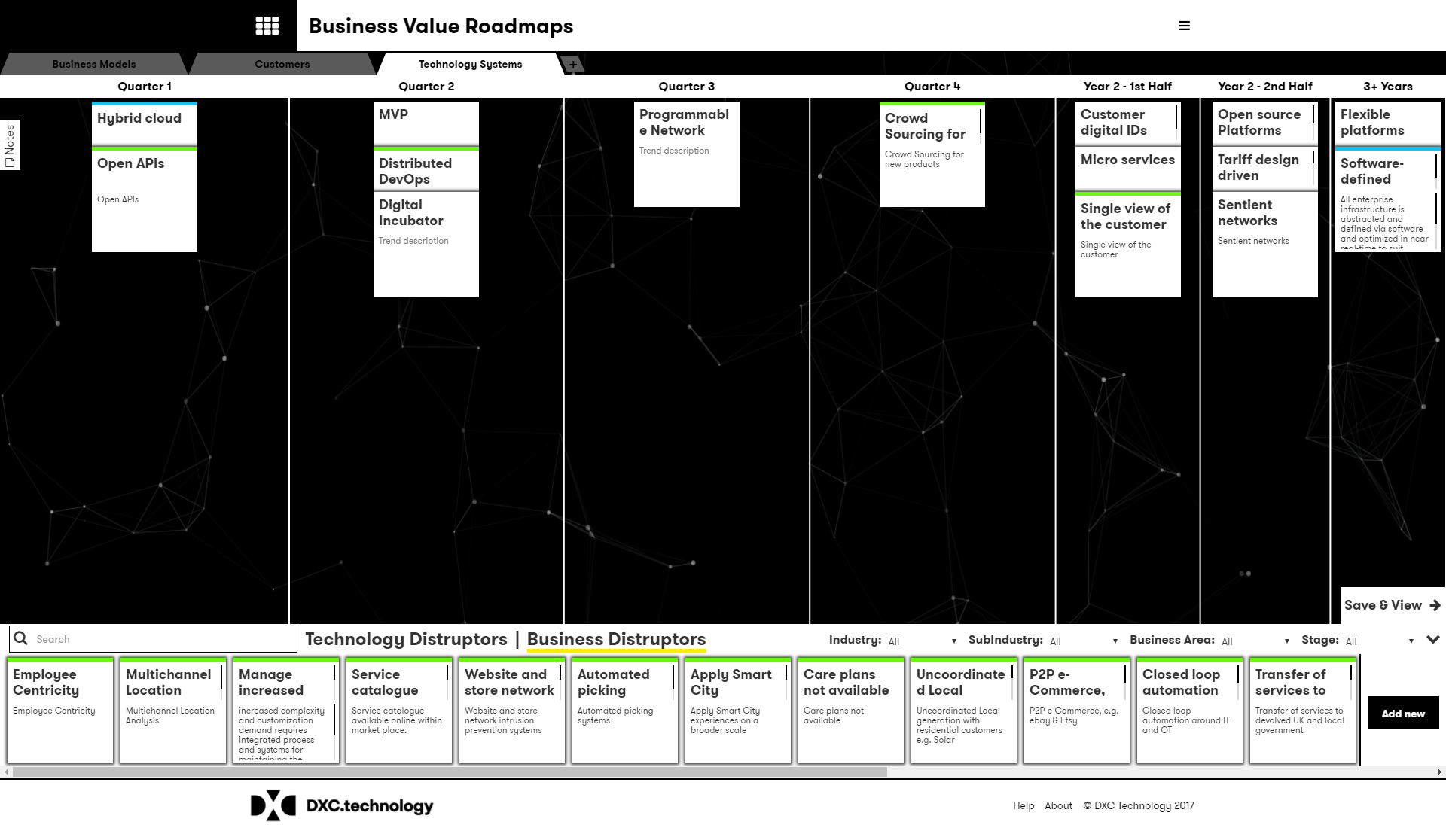
Digital Roadmap 5/5
The canvas is initially populated with any Value Chains defined on the initial page, each Value Chain is presented via it’s own tab.
If you selected a template, some initial trends may also be included.
The following slides detail how to work within the canvas.

Slide 15
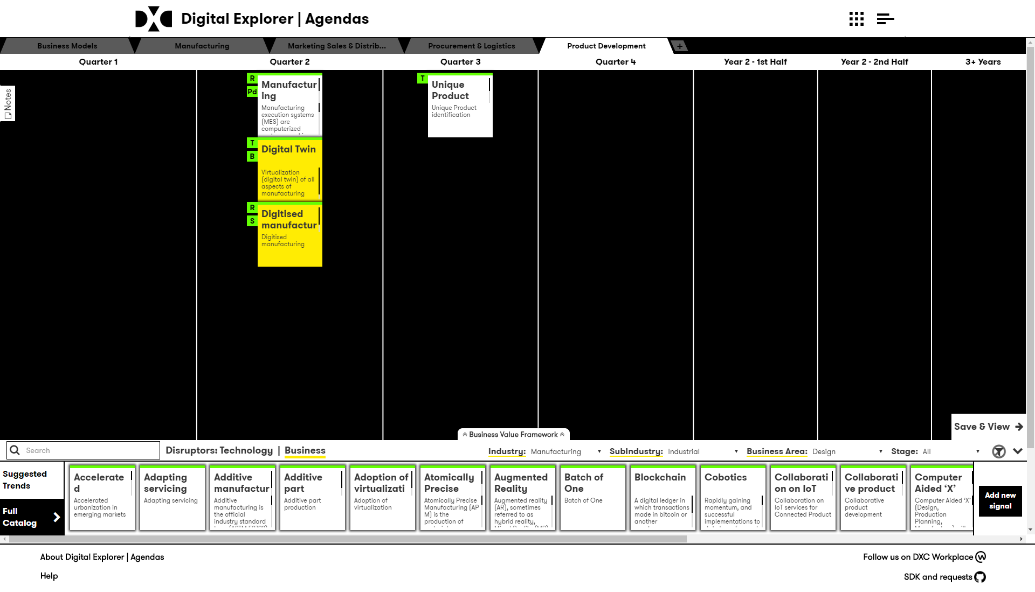
Working in the Canvas
Add new value chain
Time frame
Add Notes related to this chain value
View or add your BVF
Save & View your roadmap
The
Trend
dock

Slide 16
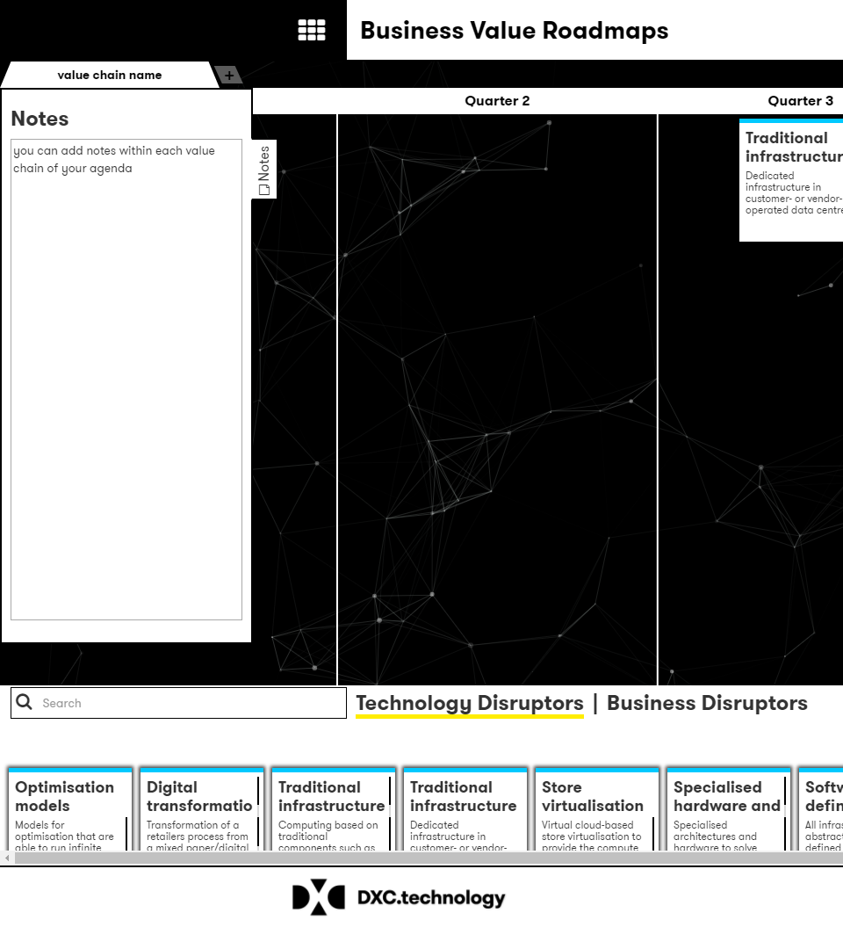
Notes
Notes can be added to each Value Chain within the roadmap.
Click on the notes tab to expand into view.

Slide 17
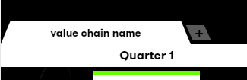
New Value Chain
To add a new Value Chain, click on the “+” tab
The information required is the same as on the initial roadmap creation screen.

Slide 18
The Trend dock
Waiting for updated UI
You can filter and search for trends relevant to the client value chain
Industry trends can be filtered based on industry, sub industry, business area and lifecycle stage.
Technology trends can be filtered based on the technology group and lifecycle stage.
Use the “Suggested Trends” to help with recommendations
If you don’t find a matching trend, you can add a new “Signal” to your client roadmap.

Slide 19
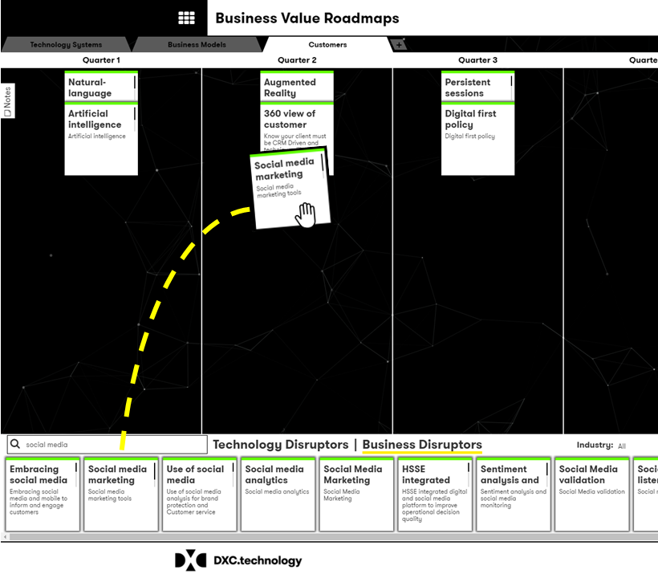
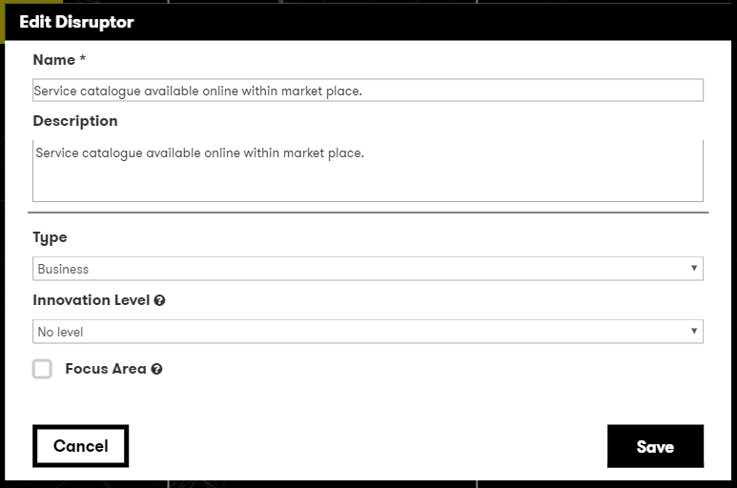
Positioning and editing trends
To place a trend within the required time segment of the value chain, simply drag and drop the trend into place.
Once a trend is positioned; double clicking will allow you to edit the trend where you can
Change/update the name or description
Define the innovation level this trend has for a client
Call out if this is a focus area
You can move a trend to another time segment or remove it by dragging and dropping it back into the dock area.

Slide 20
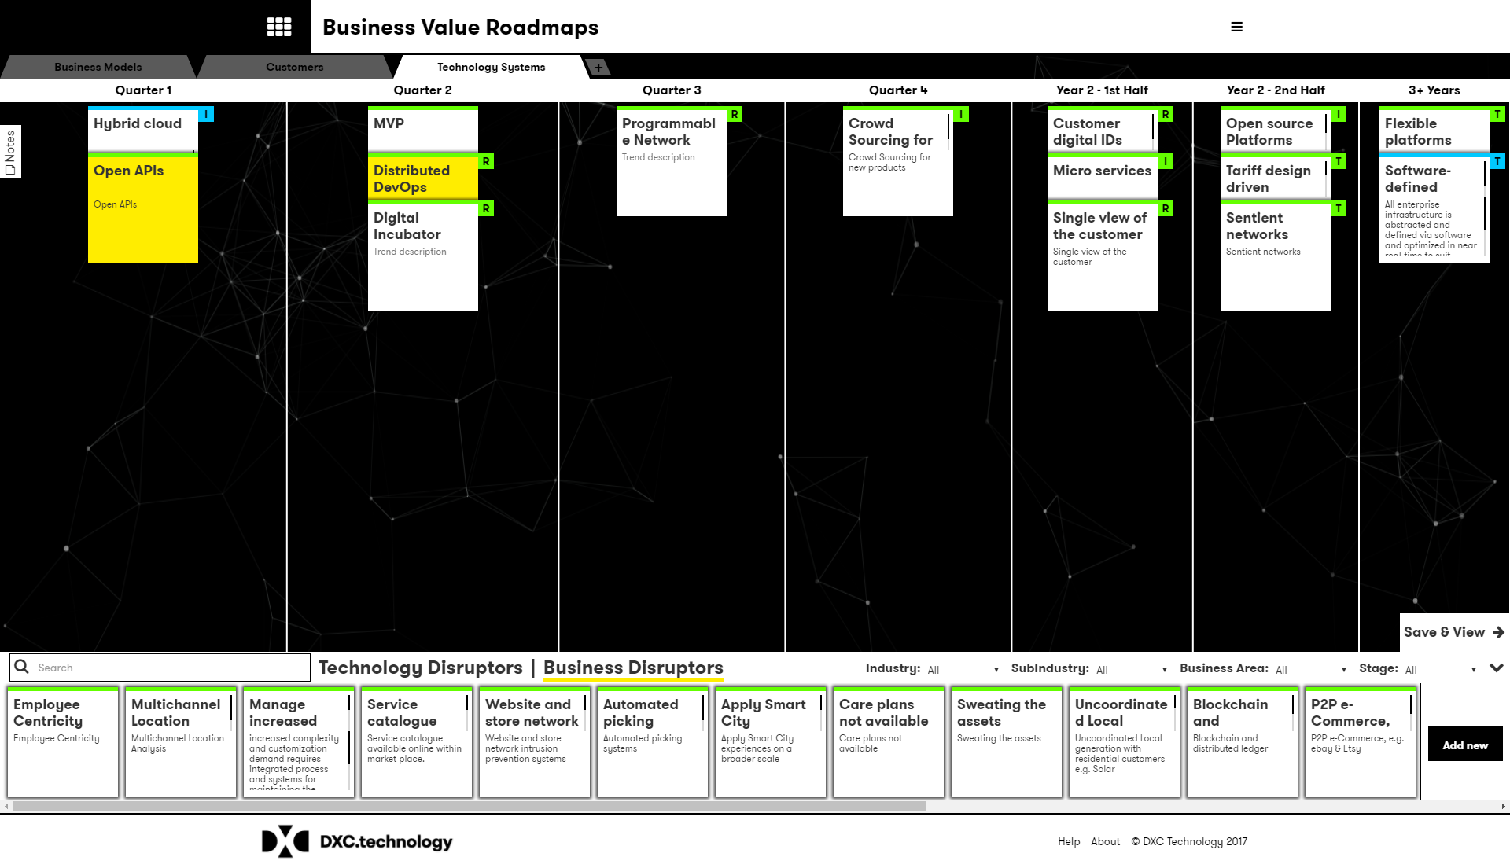
Trend Innovation levels and Business Areas
Extend the level of information for each client trend by double clicking and defining the innovation level* and associated business area* for each trend
As you add these values, a clear marker is shown within the canvas view
* See the definition of terms the descriptions of each value within these properties

Slide 21
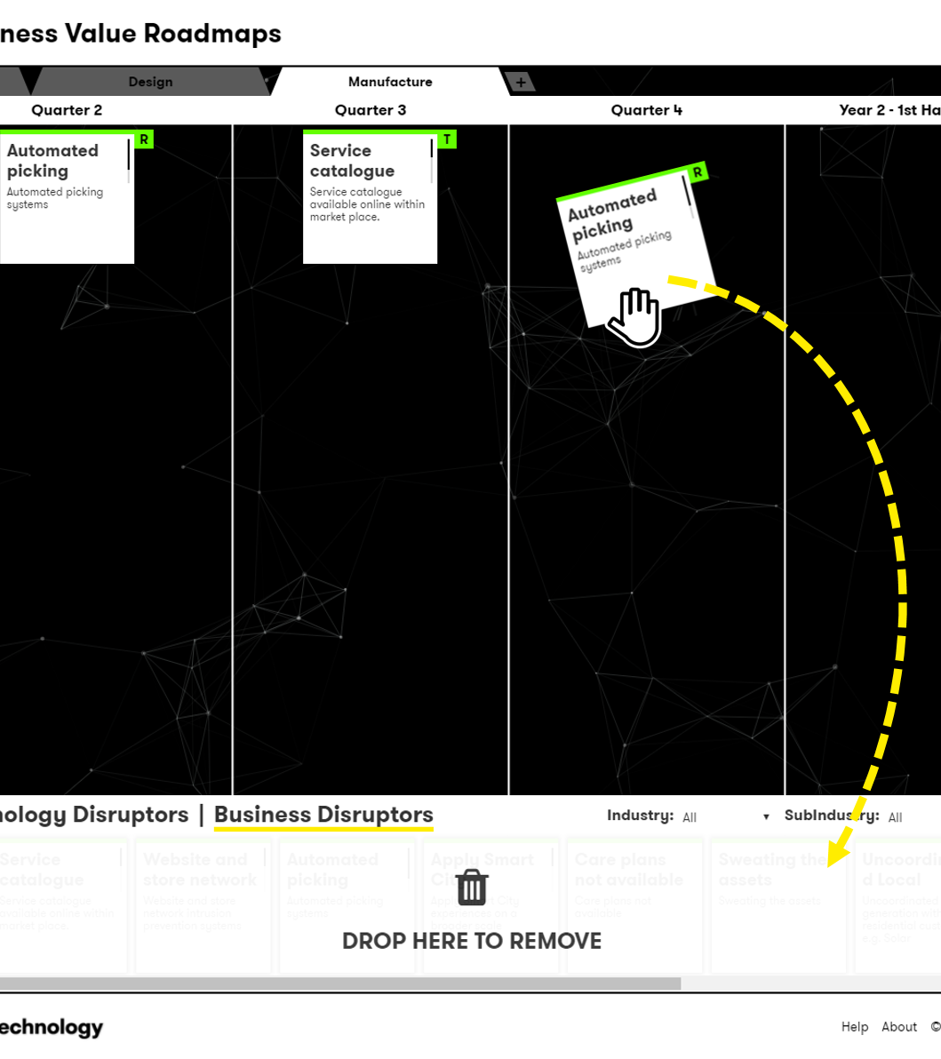
Removing Trends
To remove a trend from the roadmap, drag and drop it back into the dock at the bottom of the canvas.

Slide 22
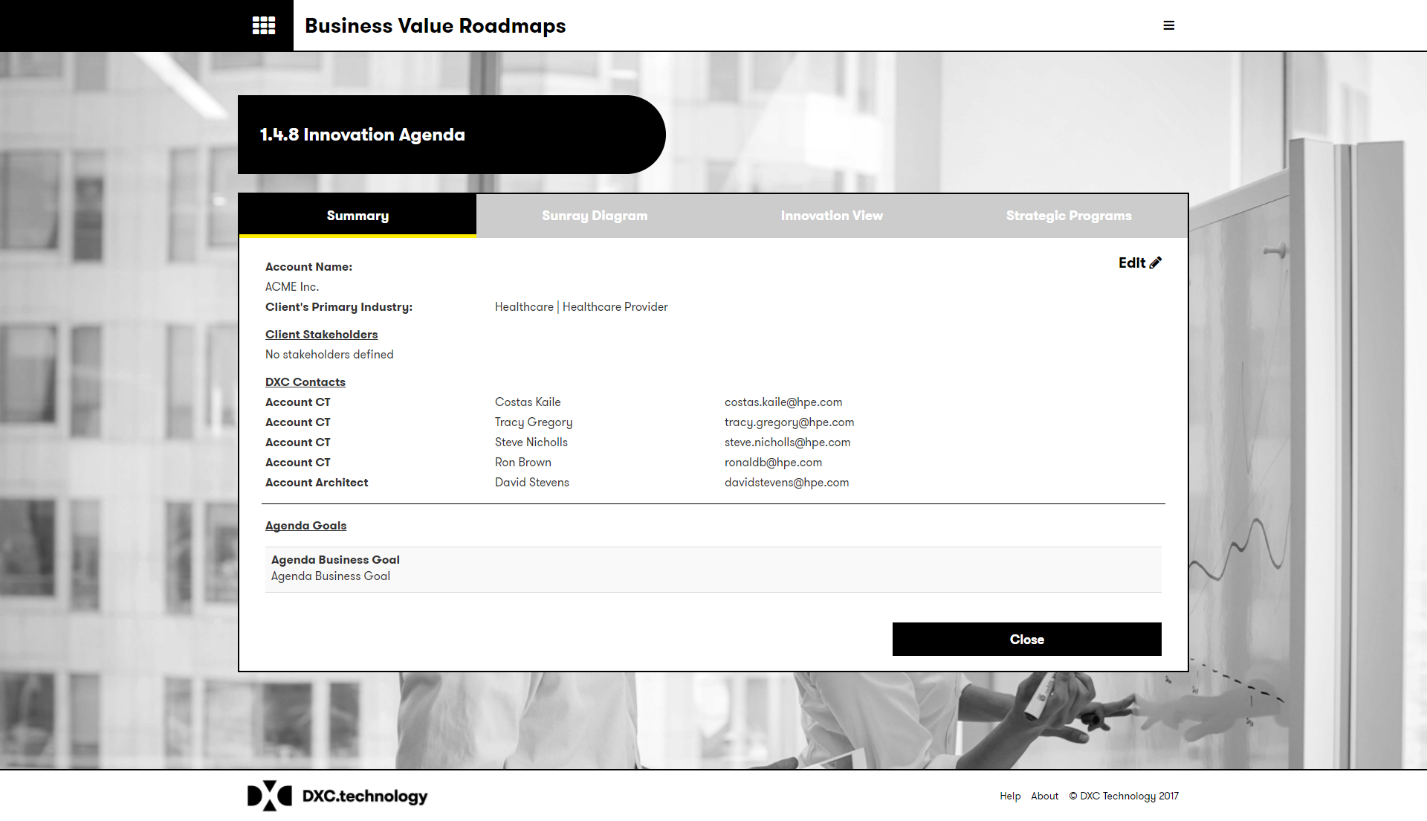
Viewing your roadmap
Once your roadmap is saved you are presented with the roadmap document.
You can also access the roadmap via the homepage and the “manage your roadmap” option.
Within the roadmap view you can:
View the sunray diagram
View the innovation summary
View and create the strategic initiatives

Slide 23
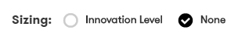
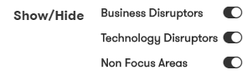
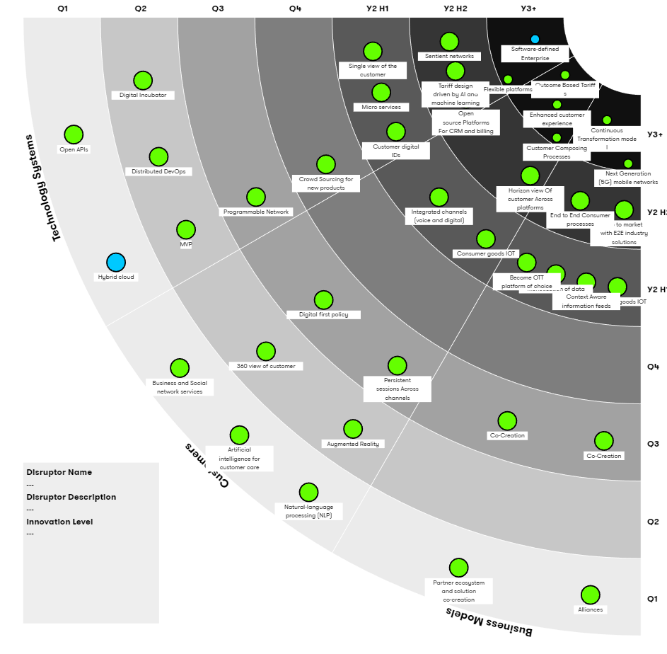
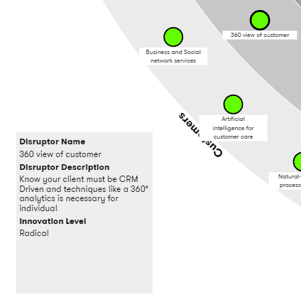
Sunray options
Within the Sunray diagram you have the options to :
Size the trends by their innovation levels
Show or hide business or technology trends
Only show the focus areas
Highlight any of the trend to review the description and other supporting information

Slide 24
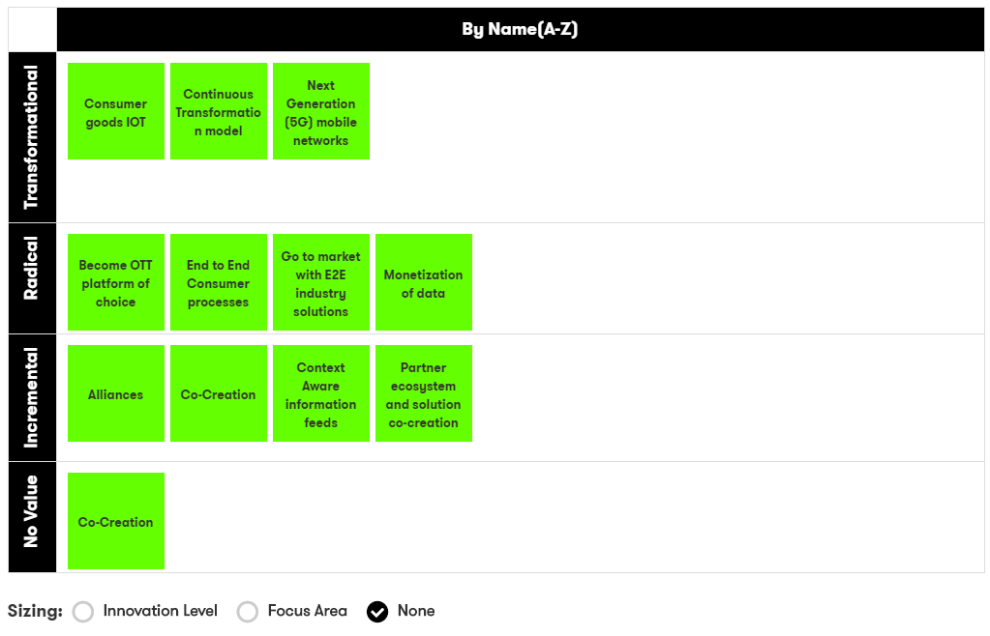
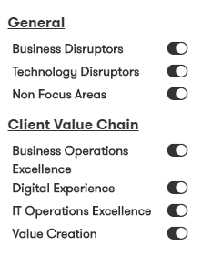
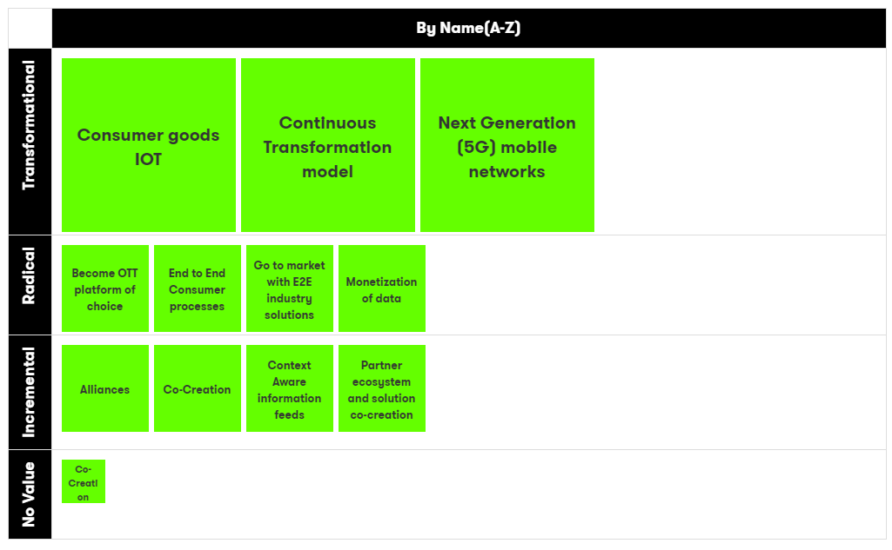
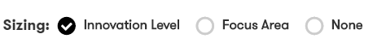
Value Chain Views
Each Value Chain is presented within a dynamic table, the default view groups the trends based on their innovation levels and associated business areas.
The horizontal and vertical axis can be altered to provide different views by mixing:
Business Areas
Value Chains
Time
Name (A-Z)
Focus area
Innovation level
Double click to edit the trend values

Slide 25
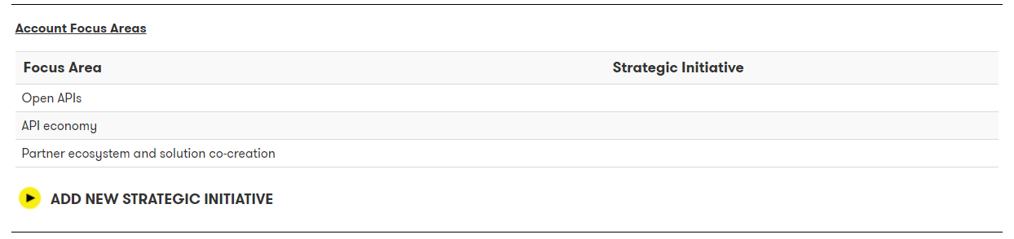
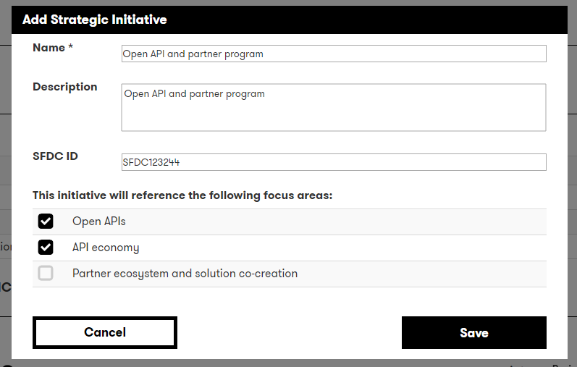
Creating Strategic Initiatives
Once your roadmap is saved you are presented with the roadmap document, from this view you can select one or more focus areas and define the Client Strategic Initiatives.
A focus area can be mapped to one or more strategic programs.
You can also select to include any client goals or KPI’s
You can update this information by returning to the roadmap summary view

Slide 26
Roadmap Insights

Slide 27
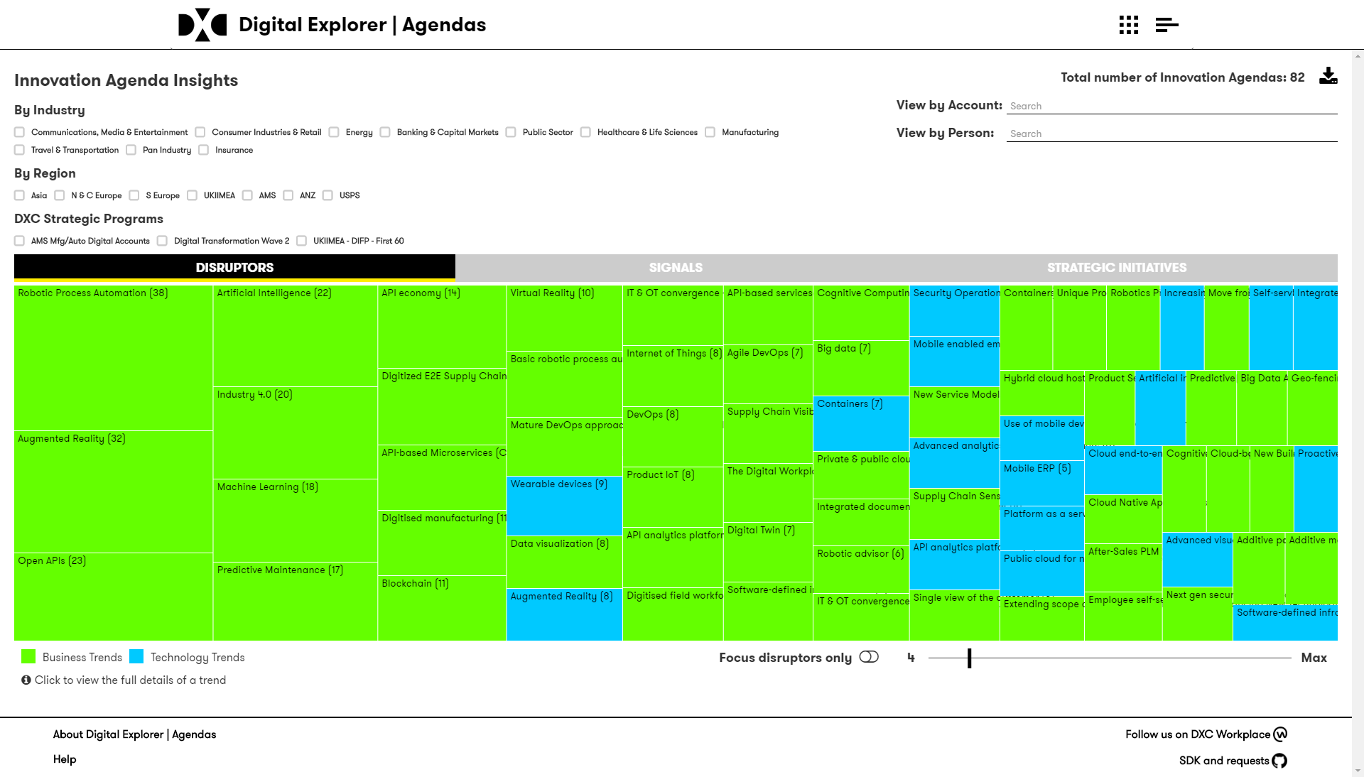
Roadmap Insights
Within the roadmap Insights section you can view heatmaps of the most referenced trends within the current valid roadmap.
You can group these by region, industry or timing.
You can also view a detailed timeline for any presented trend.

Slide 28
Thank you
For more information please contact David Stevens

